Slide 1
Accessible Word Documents
[Date]
[Presenter Name]
IT Accessibility Liaison
[Unit Name]

Slide 2
Multiple Ways
Your document must be usable for multiple modes of interaction:
Visual
Non-visual
Visual with limitations
Difficulty focusing or reading
Notes:
The first thing you need to know when you're thinking about making your Word document accessible is that you need to make it usable for multiple modes of interaction. When we're talking about disabilities, we're talking about different ways of interacting with information and with technology. You need to make your document usable by those who, may not be able to interact with your document visually, who will interact with it visually, but might have limitations, who might have difficulty focusing or reading, et cetera, who might have difficulty manipulating the document. And so you need to be thinking about these multiple modes of interaction as you're creating your document. And this is important to keep in mind because frequently when we're talking about making a document accessible, we're not just talking about users who are those who are blind or those who might be colorblind or something like that. We're talking about all of these, four ways of interacting, visual, non-visual, visual limitations, and difficulty focusing and reading.

Slide 3
Semantic Structure
Provides meaning for those who cannot see the visual layout of a document.
Indicates the relationship between bits of content
Conveys hierarchy and information flow
Notes:
I mentioned a minute ago semantic structure, and it's a bit jargony, but semantic structure basically is the meaning and the role of content in a document. The semantic structure of a document provides that meaning for those who cannot see the visual layout. If something looks like a heading, the semantic structure inside of the document will identify as a heading for assistive technologies like screen readers. You're indicating the relationship between bits of content. If it's a list, then it's going to present it as a list of information grouped for an assistive technology user. If we have a series of headings from a heading two to a heading three, et cetera, for subheadings, it's going to convey that so you get the hierarchy and the information flow as well.

Slide 4
Supporting Multiple Ways of Interaction
Clear visual hierarchy supported by internal semantic structure
Sufficient color contrast and font size
Alternative ways to present visual information, e.g., images and graphs
Use styles to add spacing – No blank lines!
Notes:
What do you need to do then to support those multiple ways of interaction? Well, first you need a strong visual hierarchy supported by internal semantic structure, and we’ll get to what semantic structure is in a moment, but don't worry about that term if it seems overly jargony to you. The important thing is that when you look at a document, you should be able to get a feel for the structure: what are the headings, what sections of the document are there, is there a table of contents, et cetera? Make sure you have visual hierarchy, white space is dividing up paragraphs, explain or demonstrate the flow of information, the structure of the document. Make sure you use sufficient color contrast and sufficient font sizes. The default Word color and font is pretty inaccessible. It's too small and it's not sufficient color contrast. We'll talk about how to fix that. You need to think about when you're including images in your document, alternative ways of presenting that visual information. Think about graphs, think about any picture you might want to use. Then you need properly styled spacing. This is the space between paragraphs, between headings, et cetera. And we'll get to this, but you want no blank lines. We often insert extra carriage returns to create vertical white space or blank lines between paragraphs, et cetera, and we can't do that if we want our document to be accessible.

Slide 5
Basic Content Structure – Heading 1
Purpose: Allow reader to confirm correct document was opened
Document Title is a Heading 1
Only allowed once per document
Must be the first heading in the document
Text should partially match the file name
Do not follow Microsoft’s recommendation to use Title, and Subtitle as document headings
Notes:
When we're talking about basic constant structure and semantic structure, the first thing we're dealing with are headings. And the first thing you're going to need is your heading 1. Heading 1 is special. It allows the reader to confirm the correct document was opened. The document title is a heading 1, so that the title that appears in your document is the first heading you should encounter. It's the only time a heading 1 should be used, and then that text of the heading 1 should partially match the file name. That way user who is blind can open a document and confirm that the file that was opened is the file they are looking for because the title and file name should match. If they don’t, then that user might waste time trying to determine where the file is that they wish to read.

Slide 6
What Is Semantic Content?
Paragraphs
Headings
Lists (bulleted and numbered)
Tables
Figures / Images
All content must have some semantic role
Decorative (i.e., artifact) is a role
Notes:
Here is the primary semantic content that you're going to be thinking about, paragraph, headings, lists, both bulleted and numbered, tables, figures and images, graphs, et cetera. And then all content will have some semantic role. It'll fall under one of these five, or it will be marked as decorative. A decorative image is one that is there for the look and feel of content, but doesn't present information necessary to understand the content, and its purpose in any way. You'll hear it as artifact in some programs, such as InDesign. That's what decorative means; it should not be there and be in the way of someone who cannot see it, who's reading this document with a screen reader.

Slide 7
Basic Document Structure – Other Heading Levels
DOCUMENT TITLE (H1)
First Section (H2)
<content>
Subheading (H3)
<content>
Another Heading (H4)
<content>
New Subheading (H3)
<content>
Second Section (H2)
<content>
Subheading (H3)
<content>
Purpose: Establish document outline
Each top-level section is a Heading 2
Headings 3 – 6 are used within sections
Do not skip levels
Notes:
Please advise your audience to use the Accessible Word Document Template provided by the Office of Access and Equity, which will set headings and structure properly.
Below is what was explained in the original presentation for your reference.
[So what about other headings? Here's what your other headings look like. To the left, we have some information in this slide about headings. And to the right you'll see an example heading outline where there's a document title that's in H1. There's two sections, a first section and a second section. Those are both heading twos or H2 for short. And then within the first section, there are two subheadings at a heading level three or H3. And then within that first subheading, there's another heading that's a heading level four. And so you can see there's a hierarchy. It's nested like Russian dolls. And when you're done with a section, you go back to an H2. And so what you're doing, you're establishing the hierarchy of information, the relationship between sections and the content, and you are introducing those sections with those heading level twos. So each top level will be a heading two. Headings three through six will be used within each section.
Don't skip levels. It's really common for us to want to do that for a general feel of headings. Let's say the heading three seems too big. We want something smaller, so maybe we choose a heading four. No. That's not what headings are for and that's not what we do. There's a way to define how they appear and if you skip levels, a person who cannot see the document, if they're using a screen reader they might wonder what they missed. Because the way screen readers interact with information is one element at a time. And so you're reading a document top to bottom, left to right. One thing at a time. You can't scan it visually with a screen reader. It's not a substitute for vision. And screen reader users rely on this document outline established by headings to make sense of the document. So if they're going along, there's an H2, there's an H3, suddenly they see an H5. They may not know what happened and may wonder what they missed and waste time going back trying to find an H4 that doesn't exist. So don't skip levels. Only use headings to start a new section.
Don't use them for emphasis. Headings have a special role. They'll be announced as a heading. So if you're wanting to bold content, use bold, use italics to emphasize. Don't use a heading for emphasis because it's intended to introduce a new section.
A final thing about headings is to make sure that same level headings in a section are unique. So for example, the subheadings to the right. I have subheading one, another heading, then new subhead. And those are different because they're at the same level. Because headings allows screener user to navigate quickly via those headings, they can jump from heading to heading, and if you've made subheadings or certain headings that are at the same level, have the same text, then they have to waste time looking around the heading to make sure they're at the section they want. So your heading should be uniquely descriptive. [They should be concise, and if they're in the same section, they need to have different text. Note that in the second section here, I have another heading with subheading. It's the same as that previous section, but because it's preceded by a different heading level two, then that confusion won't exist. And then that's fine to do.]

Slide 8
Semantic Structure: Lists
Lists group information that comes as a series of items
Bulleted lists when the order of the items does not matter
Numbered lists when the order does matter, e.g., instructions
Notes:
Another semantic structure are lists. Lists group information that comes in a series of items. This seems obvious, but it's important to know that if we're using a list, then we need to make sure it's a list under the hood. So bulleted lists are used when the order does not matter, like ingredients in a recipe. Numbered lists are used when the order does matter, like the steps in a recipe. Lists are pretty easy to do in Word, it's automatic. In fact, it's really hard to not use a list in Word, thankfully. But we need to make sure that we use a bolded list when it's appropriate and a numbered list when it's appropriate.

Slide 9
Semantic Structure: Tables
Tables are for tabular data, i.e., data that has a row-column relationship
Do not use tables for visual layout
All table columns must have a heading
Do not merge or split table cells
Do not use blank table rows
2022 | Chrome | Edge | Firefox | Safari
May | 79.9% | 7.3% | 5.3% | 3.8%
April | 80.3% | 7.2% | 5.3% | 3.8%
March | 80.3% | 7.5% | 5.3% | 3.7%
February | 79.9% | 7.5% | 5.4% | 4.0%
January | 80.1% | 7.3% | 5.5% | 3.9%
Notes:
Tables are another important structure. Tables are for tabular data, which is data that has a row-column relationship. You can see to the right, we've got a table shown for browsers statistics for 2022. Across the top, we have four common browsers: Chrome, Edge, Firefox, and Safari. Down the left, we have five months of the year: May, April, March, February, and January. And everywhere there's a column and row, where they overlap, we have a statistic. For example, in April Microsoft Edge was used 7.2%. That column-row relationship is necessary to convey that data in a concise manner. Tables cause screen readers and other assistive technologies to change to interactive mode, anticipating that it's used for tabular data. That means that if we use tables for visual layout, we are misusing that data structure, will cause confusion, and make it difficult to read the document. Don't use tables for visual layout. Use them only for tabular data.

Slide 10
Semantic Structure: Images
Users who are blind cannot see image content
Images that convey information must have a concise alternative description
Decorative images must be marked as decorative
Images containing text are not decorative
Logos are not decorative
Images used as the only content in buttons and links are not decorative
Notes:
Images are another semantic structure. They're announced as image by the screen reader to alert the reader that they are there. Some people assume that the screen reader will somehow describe that image. Image content is invisible to users who are blind, and so we need to have some alternative for presenting the key points of that image. And that's where we are using alternative text, or alt text. Some things to keep in mind is that alternative descriptions must be concise, unique, and tell the reader what information is being presented. Try to keep alt text to two short sentences that describe the key points of the image for its use within that context. If the same image is used in multiple places and the context changes, that alternative description may change.
Not every image though presents information. Some images don't contain any text, they're not a logo, it's something for the look and feel. Think of a Christmas card where we have a beautiful, picture of some pine cones and some pine needles for a fur tree. It doesn't present information from the card. So a decorative image would then be omitted from the document structure. Mark those types of images as decorative. Remember, if it contains text, it's not decorative. If it's a logo, it's not decorative. Logos are considered branding and give authenticity to documents.
If you want to use an image as a link, please contact me or your accessibility liaison for information on how to do that. Hint, those images are never decorative.-- (Add why?)

Slide 11
Use of Color
Ensure color contrast is sufficient
Only use orange/white color combinations for text >16pt and bold.
Rule of thumb
If you are not sure a color combination has sufficient contrast, it probably does not.
Notes:
Use of color is our last basic. Color contrast is something that we tend to take for granted in that, most of us can perceive color with no problem. We tend to like subtle color combinations. And unfortunately that doesn't work for many people. Some people have a form of colorblindness and others have difficulties perceiving certain color combinations.

Slide 12
COLOR accessibility ON THE WEB
 | FF5F05 | 13294B | C84113 | F5821E | 009FD4 | 1D58A7 | 1E3877 | F8FAFC | FFFFFF
FF5F05 | X | ✓ | X | X | X | X | Large font | X | Large font
13294B | ✓ | X | X | ✓ | ✓ | X | X | ✓ | ✓
C84113 | X | X | X | X | X | X | X | ✓ | ✓
F5821E | ✓ | ✓ | X | X | X | X | Large font | X | X
009FD4 | X | ✓ | X | X | X | X | Large font | X | Large font
1D58A7 | X | X | X | X | X | X | X | ✓ | ✓
1E3877 | Large font | X | X | Large font | Large font | X | X | ✓ | ✓
F8FAFC | X | ✓ | ✓ | X | X | ✓ | ✓ | X | X
FFFFFF | Large font | ✓ | ✓ | X | Large font | ✓ | ✓ | X | X
* Office of Strategic Marketing and Branding
Notes:
You see here on this slide a grid of information. This is from the Office of Strategic Marketing and Branding. It's a table showing the color combinations that are in the color branding that public Affairs has published, and it shows which combinations work. If something say No, that means those two colors do not have sufficient contrast if you try to use them together. The foreground would not be perceptible from the background, so the text wouldn't be able to be read. If it says Large font, that means something can color contrast works fine, but only if it is large text, and that would be text that is greater than 16 points and bold. And if you try to use it for something smaller than that, it will not have sufficient contrast. There are other colors combinations here that say Good. This means the combination works fine at all text sizes. Pay attention to what you're doing with your color contrast. A good rule of thumb is if you're not sure that a combination has sufficient contrast, it probably doesn't. Error on the side of higher contrast than you might think you need.

Slide 13
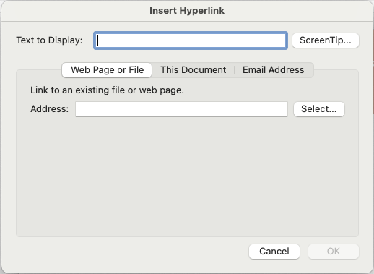
Hyperlinks
The Link address should not be used as link text
URLs are not considered human readable
Go.illinois can be an exception
Link text should describe where the link will take the reader
Notes:
The URLs of the links are not human readable, it'll be read as a long string of letters and numbers with no spaces. So URLs should not be link text, instead, you need the human readable text or link text as we call it. The link text should describe where the link goes. And you want it to be concise. Don't use a paragraph for a link. Don't use a whole sentence for a link. Use a word or two that will be descriptive. Go to Illinois short URL is an exception that we've promoted because it's a short, human readable, and memorable URL. If you really need to have that URL listed in the page, then use a link with descriptive link text, and that's your live link. Follow that with the URL in parentheses and make sure that is not a hyperlink. That way a person reading it is going to get to the active link, a descriptive link text, and then afterwards if they browse past that, they'll get to that URL and they'll be able to figure out, "oh, hey, this is the URL, and I'm gonna skip it", so they can skip past that. It'll skip as a single word for them. So that's the best of both worlds. If you're distributing and print, or you think it's going be printed, that makes sense to do if the URL's needed. If not, and you're just distributing electronically, use your descriptive link text.

Slide 14
General Workflow
Define built-in styles for use
Use styles as needed
Set alternative text for images
Set title in document settings
Run Accessibility Check tool
Notes:
So here are the five steps to ensuring your Word document is accessible. You want to define built-in styles for use. These built-in styles will give the semantic role of the information. Use those styles as you need. Again, use them for headings, use them for lists, use them for tables. Make sure you set alternate text for images. Set the title and document settings and that helps with identifying the document. And then you'll run something called the accessibility check tool, and you may already be aware of that tool. It's very useful but there are some limitations to it to be aware of. But that is the five steps. None of these are difficult, it's just needing to know to do them. Let's begin.

Slide 15
Let's Practice!
Notes:
That's the basics of semantic structures: headings, image alternative text, use of tables, lists, and color.
Now let's talk about how that's done in Microsoft Word.
This is where the interactive portion starts.

Slide 16
Step 1: Defining Styles
Notes:
So here is a Word document. Using the Microsoft Word for Windows.
There is a difference between the Microsoft products for Windows and for the Mac, and there are some features available in Windows that aren't available on the Mac. So if you're using a different machine, follow along as best you can.
So here's a document that has good visual hierarchy. It's best practice for making word documents accessible. I can tell what my title is. I can tell that my text is not a heading. I can see my headings and I can see there's a list here, and so I can figure out how the information is structured as I scroll through it, so that's really good. Unfortunately, this document is not accessible and even though it looks great, the reason why it's not accessible is it has no semantic information. It did not use the inline, the built-in style.
If you look in the ribbon about the middle of the ribbon, there's this large white box with the word styles under it, and it's got normal, heading one, heading two, heading three, heading four, et cetera. Title and so on. Those built-in styles are what give that extra semantic information for assistive technologies. It's under the hood, so to say, and you wouldn't know about it if nobody told you. We need to make headings actual headings, and not just look like one. So let's make our entire document normal text and then we can get to work.

Slide 17
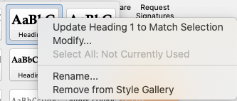
Two Ways to Modify Built-in Styles
If setting up styles initially:
Change font and appearance as desired
Select the styled text
Right-click on the appropriate style in the Style Menu
Select “Update XXX To Match Selection”
If changing applied styles:
Right-click on the appropriate style in the Style Menu
Select “Modify…”
Notes:
So what we're going to talk about now is how to make redefine these built-in styles to make them appear the way we want because they're really what's built-in for Word isn't useful or very accessible.
So what I have here, I have the style that I want Heading 1, but the font's too small, et cetera. So we need to update our built in style settings.

Slide 18
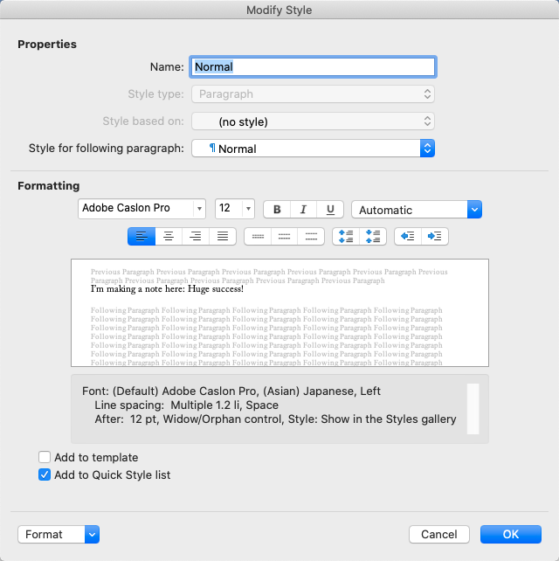
Define Normal Paragraph Style
Must define:
Font
Font size
Line spacing
Paragraph spacing
Avoid decorative fonts
Font size should be 12pt or larger
16pt for large print requests
Use the “Automatic” color for black text
Necessary for Inverted High-Contrast modes
Notes:
Let's first tackle paragraph style as most content in a Word document is going to be paragraphs.

Slide 19
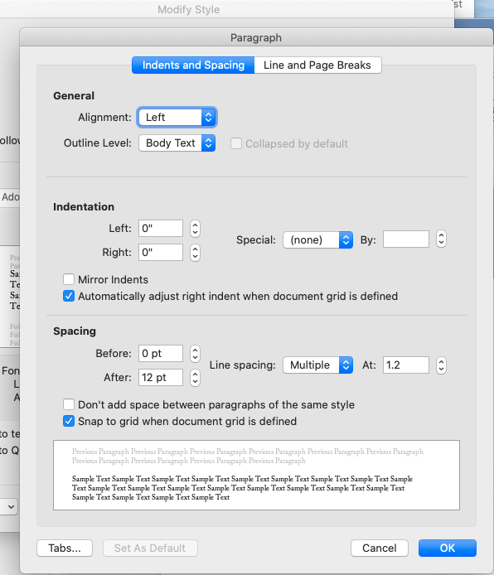
Set Line Spacing
Set default line spacing between 1.2 and 1.5
Right-click on style to modify and select Paragraph from the Format dropdown (bottom of window)
Enter the desired value to the right of the Spacing options.
Notes:
On the tool bar I'm going to click on the expansion arrow at the bottom right corner of the paragraph section. Now I have a dialog box that I can adjust settings.
Assuming our language is English our paragraphs should be Left aligned, no indentation, no spacing before a paragraph, 12pt spacing after a paragraph and we want multiple line spacing. Here we get to pick a number and it is recommended to choose something between 1.2 and 1.5, depending on the font choice. This is to spread out the lines within a paragraph so that letters that dangle below or ascend above the line of text have space to be read clearly. For this document, I'm going to choose 1.2.

Slide 20
Set Paragraph Spacing
Do not use blank lines!
Blank lines are announced as ”blank” by screen readers – this is both annoying and distracting
Change the Paragraph spacing for the appropriate built-in style
Right-click on style to modify and select Paragraph from the Format dropdown (bottom of window)
Can override spacing from the Line Spacing options in the Ribbon.
Click on the Line Spacing button and select “Line Spacing Options…”
Notes:
We change the spacing after a paragraph so that we don't have to have to hit enter multiple times to spread out the paragraphs. Remember that a screen reader will read "blank" for each blank line. The spacing after the paragraph should match your font size.
Now we need to remove those blank lines from our document and you could use your arrow keys to try to find them but if we click on the hidden formatting button (looks like a backwards P) then you'll see where those paragraph spaces were inserted and we can quickly remove them. Then you can turn your hidden formatting button back off.

Slide 21
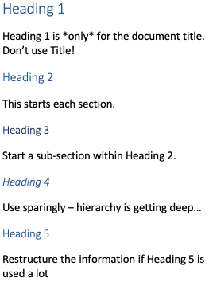
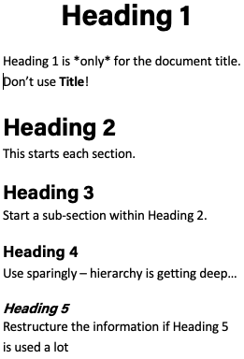
Define Heading Styles
Default headings are not sufficient
Color contrast is low
Visual hierarchy is poorly established
Establish visual hierarchy
Heading 1 larger than heading 2, and so on
Visual “weight” must be greater than paragraph text
Headings must be closer to their respective paragraphs than to preceding content
Notes:
We've setup are paragraph styles but we need to adjust our style/heading font properties.
So we've set up our paragraph styles, and the rest of this is gonna be a little bit of a repeat of this type of thing. We know we want. Headings to be a certain way, and we've already modified those in this document and we don't want to throw that away. And so we're wanting to keep it. So instead of replacing it, we're going to modify, or instead of coming up with something from scratch, we're gonna try to preserve this. So I could, just to show you, here's what the default word heading one looks like. This is terrible. Partially. You can't really tell much difference between the different heading levels. Heading one to heading two. There's a huge difference, but heading two to heading three, not so much heading green to heading four, not so much. Also, there is no the color contrast is very poor. The, that blue on white, that particular shade is not sufficient and so it will not work for many users and so we can't use the, that default heading. And then the final thing is that headings, you don't really want your headings to be spaced evenly between the text that it's introducing and what comes before you want the heading to be closer to where it's coming. This is a form of chunking where you're presenting information in a way that it feels connected to someone. And it makes it easier to parse a document and understand what's related. And so we're gonna fix that by changing our style. So I'm gonna undo what I did.

Slide 22
Step 2: Using Styles
Notes:
I'll go to your heading one in a quick update to match selections since it's already what I want. So there we go. I've already done that, and it applied it. Let's go here. Let's do the same thing for heading two.

Slide 23
If It Looks Like A Duck…
Everything in a document will have some built-in style
Normal is the default style.
Everything with this role is a paragraph to assistive technologies
Changing the appearance of something does not change the role
Must apply a different built-in style to change the role
Lists automatically have the list style applied
Tables have table styles applied
Do not use the Draw Table feature – More on that later

Slide 24
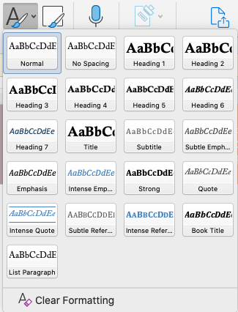
Using Styles for Headings
Just because it looks like a heading does not mean it is a heading!
Large fonts in a bold or underlined typeface is not perceivable by readers who are blind
Use headings in the correct order (do not skip levels!)
Heading 1 for the document title (Do not use the Title style)
Heading 2 for each new section
Heading 3 and so on within each Heading 2
Notes:
Now I did that here, but note that it's not applied here. So just updating the Mac selection, it will apply it where I updated it, but it won't apply it throughout the document. And so I need to go through and make sure that I click on each heading two and set that up. This important note is a heading three, so update to match selection. There we go. So I've done. But I do have an issue where my line spacing is poor. So even though I've set those up, I'm now going to go in and modify this and go to paragraph and I'm going to change what comes after the paragraph, because I don't really want much space there. I do want more before the paragraph. So typically one and a half times your lines, your font size. So 18 points in this case, half a line after six points. That's a pretty good place to start. You can modify it. The important thing is that it's clear to see that there's more space above this heading than below, and there's a little bit of space between the heading and the text that follows it. So it's not difficult to parse. This will change again based on the font that you use, so use your best judgment. But as a general rule, one and a half times the space before, half a line after, and you're good to go there and notice how everywhere I applied it, it went ahead and updated it throughout the whole document. Down here, it's not updated because it hasn't been applied. So using those built-in headings actually helps you change the look and feel your document so you're not risking or having to remember what did I set that font size as from a headings. What color did I use? What was the line spacing that I used for that? You don't have to remember that because it's recorded in the style. So here's a heading three. I'm going to go ahead and modify. So again, I don't want that after one and a half lines again. There we go. And so that now updated throughout. Here's one that didn't for some reason. Why not? Ah, that's because I didn't set that heading. There's another way you can check we can click on it and look. And guess another thing we can do is we can go to view. And under view there is the navigation pain. I click on the navigation pain that's going to show me the headings in my document. And so if I look at this and I notice something is out of place. Let's say I set that as an H two inadvertently. I may not notice that if I'm scanning through document quickly in this outline though, I can tell that is at the same level as check accessibility while you work. That's an error I know to go fix that. Now if I click, I'll jump to that in the document, and now I can just fix that. I know I've got built-in headings and styles. This isn't appearing, so I obviously missed one, and so I can click on that and make it a heading. So that's how to set up headings.

Slide 25
Lists
Word likes to convert anything with a bullet or a number to a list
If you use one of the list styles, a list automatically has the correct semantic role applied
Indent as needed to nest list levels
Notes:
So now we have a document that I'd say is mostly accessible. We have our heading structure. It's very legible as far as the white space used. We know it has that semantic structure in place. The last thing I'm going to check is this list. It's very difficult to not make a list in Microsoft Word, but the way you check that is just click on it somewhere and see if this list box is highlighted. If it is, then you're in good shape, so that's what you'll do. This is five steps. The steps are in order. It's a series of steps to use in a workflow. So using a numbered list makes sense here. If not, I'd want to use a bulleted list. Again, you'll use your judgment and determine "do I need a numbered list or not?". If I don't need a numbered list, if the order doesn't matter, then I should use a bulleted list because that's less information that a screen reader user or another technology user has to listen. They don't need to have the number getting in the way of reading of the text when it's not important.

Slide 26
Tables
Do not use tables for layout
Tables are for tabular data
Use the columns features of Word to create two or more columns
Do not nest tables
Do not merge or split table cells
Insert tables – Do not use the Draw Table feature
Drawn table will not be accessible via a screen reader
Table appearance does not change table role
Notes:
Let's say I want to insert a table, so I'll go here. And when you're inserting a table, you don't want to use the draw table feature. The draw table feature will cause that table to be rendered an image. With markup, that's a little bit weird for the screen reader. So you don't want do that. Instead, you're going to insert a table. So go to insert click table and then decide how many rows and columns you want. You can do that by going to insert table and putting that information in. So I'm going to say, three by three. [Create a table with data that is relevant to the audience.]

Slide 27
Tables (continued)
All tables must have a header row and column specified
Specify table headings by checking Header Row and First Column in the Table Design tab
Insert a Table caption by selecting the table, right clicking and click Insert Caption…
Table captions describe the purpose of a table
Allows users who are blind to quickly find a table they may be looking for
Notes:
Okay, so I have a table. What I need to do is make sure this table looks good. So I could go to the home tab, bold text or get rid of the space after the paragraph, etc. But I need to ensure that programmatically behind the hood, the semantic information for these rows and columns are present. There's a couple ways I can do this. The best way is to click on the table, go to the table design tab in the ribbon, and then make sure that header row and first column are checked. If you hover over them, it tells you that special formatting for the first row and column of the table is applied. What it doesn't tell you is that it will also identify these as table headings for the assistive technologies. They've completely hidden that information from you, so you wouldn't know that was needed if you, no one told you I could come in here and change this. Now, this table is pretty good, but there are a few more things that I need to do though.
I need a caption for this table. The caption identifies the table to the screen reader users so they can determine if they want to read that table or not. I'll select the table and then under the References tab in the Ribbon, I'll click "insert caption". In the Label list, select the label for Table and type some descriptive text that you want to appear after the Table label (e.g., Table 1: Sales from 2020-2022), and then click OK. I'll also add some alternate text to the table. Alternative text is used mainly to help screen reader users understand and navigate complex tables. To add alternative text to a table, I'll menu-click the table, select Table Properties and then the Alt Text tab​. I'll type a concise, one-sentence description of the table in the Title field, and I may enter the summary information for the table in the Description field as well.
[I'll use automatic for the color. This is an important thing when you are setting a color to black in Word, don't use. Now that based counterintuitive, I'm setting it to black. Why can't I just use black? The reason for that is that if you set it to black and a person, especially at a Mac, Macin or a Mac Os is displaying their screen with colors inverted, then what's going to happen is that black color is going to be inverted to white and depending on the color back. They won't be able to see the text very well. So instead, you wanna use automatic anytime you want black and it has a nice, helpful square next to you to automatic. So you'll want to do that so that it is visible in high contrast, inverted color modes.]
What you can do if you want, you can go in, you can define your normal and headings. You can then delete all the content in your file after you've defined it. And go to file. Go to save as. That's the wrong file. Save as and save it as a word template. Dot. After you save it, give it some description of what you, of what the template should be, and then you will put it in, you will save it to this folder documents, office templates, and save it here. And once you save it there, every time you create a new document in Microsoft Word if I go to. It'll, that template will show up here as an option to choose, and so you can click it and you have that option at that point.

Slide 28
Step 3: Alternate Text for Images
Notes:
So let's see. Where are we? We have headings, we have texts. So another thing we need to think about then is our image. We want images.

Slide 29
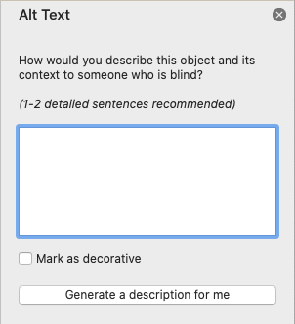
Step 3: Alternative Descriptions for Images
Users who are blind cannot perceive image content or purpose
Supply concise, descriptive alt text for each image
Right-click on the image and select “Edit Alt Text…”
Select the image, choose ”Format Object” from the Format menu, and select the ”Alt Text” tab
Consider how you would describe the image when talking on the telephone
If the image is decorative, check the “Mark as Decorative” checkbox on the Alt Text tab
Notes:
I'm going to insert an image here. Now we need to make sure it has appropriate alt text to describe it. And the best way to do that is to click on the image, and click view alt text. When you do that, it's going to open a panel to the right. And give you some reminders of how would you describe this object to someone who is blind or low vision? What I like to say is, how would you describe to someone on the telephone who can't see it? If you're reading the document and the image is there for key points, what are those key highlights you describe to someone? And then enter them in this text box. One thing you note here, Microsoft Word may have already put something in this text box here. It auto-generated it. But auto-generate text typically doesn't tell what the key features of the image are, so I would replace it with a concise description of the image.

Slide 30
Step 4: Document Title
Notes:
And beyond that, you need to set your document title and you're done.

Slide 31
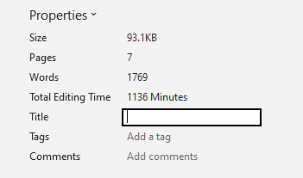
Setting Document Title
Set document title in the Summary tab of the Document Properties window
Choose File > Info (Windows)
The Title text should closely match the title in the document
The document filename should also be similar
Windows Version
MacOS Version
Notes:
So to do that, I'll go to file, I'll go to info, and to the right here under properties, I can add a title. There we are. I've set that.

Slide 32
Other Considerations

Slide 33
Page Headers and Footers
Avoid placing essential information into the header or footer
If exporting to PDF, the header and footer contents will be exported as an artifact (hidden from assistive technologies)
Document title should not be in the header
If duplicating as a running head, i.e. for journal articles, use a Heading 2 style
Override for the desired appearance
Supply alt text for images (or mark as decorative)
Remember that logos, such as the Block I are not decorative
Notes:
Here are other considerations, headers and footers. You don't want to put essential information in the header or in the document footer. For example, the title of the document should not be in the header or footer. The reason for that is because the header is not easily accessed by a screen reader. To users of assistive technologies, it's assumed the header doesn't contain essential information. And it's often repeated information on multiple pages, a user has to do something extra to get to that header and footer to read it. If you export the PDF, it becomes an artifact and won't be read the way you want it to be read. If you have a running head, for example, for journal articles, put it as heading 2 and style it as you desire. If you supply images, provide alt texts for those images, even though it's exported as decorative to PDF from your word document, a person might browse to that.

Slide 34
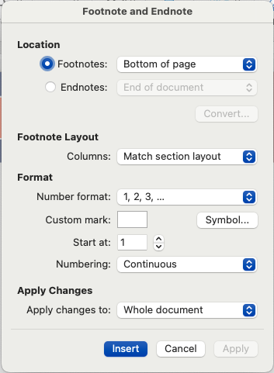
Footnotes and Endnotes
Use the insert Footnote feature for footnotes
Footnotes and endnotes may be styled
Notes:
Footnotes and end notes. As long as you use the footnote and end node feature, there's no problem with them. So before and after the document.

Slide 35
Other Items
Do not use text boxes – not screen reader friendly
Do not use Smart Art
Shapes must have alt text – treat them like images
Notes:
Other items - don't use text boxes. They're not screen reader friendly. A person can't navigate to them to read what's in them and they'll read out of order. The same thing with smart art. Smart art does strange things. The words are no longer read because they're now an image. Shapes must have alt text. Treat them like images. If it's decorative, make it decorative. If it conveys information, add descriptive alt text.

Slide 36
Step 5: Accessibility checker
Notes:
How do we know we've done everything correctly? That is what we will use the check accessibility tool for. The built-in accessibility tool can be accessed in two ways.

Slide 37
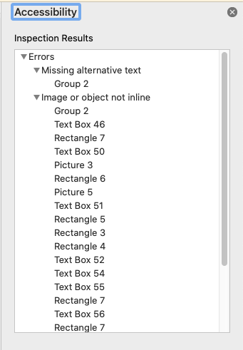
Accessibility Checker
Open two ways:
Review > Check Accessibility in the ribbon
Click on “Accessibility: Investigate” or “Accessibility: Good to go” at bottom of window
Tool can only show you errors, not what needs doing
Ex. If no headings, no heading errors
Will check accessibility as you type
Notes:
One way is to go to review and click check accessibility. That'll open a new panel on the right. The other way is down at the bottom of the window, there's an accessibility status indicator. If it says "Accessibility: Investigate", you click it, it'll open the check accessibility tool. Now, the check accessibility tool is good to tell us that what we tried to do is correct or not. It cannot tell us about things that we didn't do at all. So if I didn't use any built-in styles, it's not going to tell me anything about the built-in styles. If I tried to use built-in styles for headings then it will tell me if I did that correctly. In this case, it's telling me I'm missing alt text, and if I click on that, it would scroll to where that image is and highlight it, and it gives me the option of marking it as decorative, which is what I would do if this was a decorative image or adding a description. Now, if I go back to the accessibility check tool, it gives me a nice green check box or check mark. It says, no accessibility issues found, and it says "accessibility: Good to go", provided you followed the workflow and did everything the best you could. If you didn't try something, didn't use built-in style. Then it's going be a problem if you mark an image as decorative when it should have had a description. It can't tell you that if you forgot to enter alt text and instead Microsoft suggested their alternative.

Slide 38
Export to PDF (Only if Needed)
Notes:
Now that's done, this document is fully accessible and I'll be able to export it.

Slide 39
Converting to PDF (1 of 2)
Only convert if you need to
Word documents are more accessible than PDFs
Save As PDF—do not print to PDF
Choose “Best for electronic distribution and accessibility”
Creates a “tagged” PDF
Will need to check the PDF afterward
Notes:
If I want to export it to PDF, I'll go to save as and select PDF, and then clicks save. Under more options. If I've changed this, I need to ensure that is standard publishing for online and printing. If you do minimum size or you print to PDF instead of saving as PDF, all that work you just did to make your semantic information present in the document is thrown away and so you get a PDF that cannot be read by someone. If it's standard, the PDF you get is going to be accessible.

Slide 40
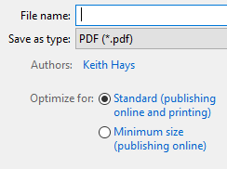
Converting to PDF (2 of 2)
Windows
MacOS
Notes:
That is how you create an accessible Word document and convert it to PDF.

Slide 41
PDF Accessibility
Gotta Check Em’ All!

Slide 42
PDF Documents
PDFs can be made accessible
Almost always require some manual correction
All content must be “tagged”
Semantic structure needed for assistive technologies
Use the Accessibility Tools to guide you
May need to add Accessibility Tools to your sidebar

Slide 43
PDF Workflow
Run the Accessibility Check Tool
Check tag use (headings, lists, tables, link, etc.)
Check tag order (reading order) if needed
If there are issues:
Correct the source document (if you have access) and recreate the PDF
Fix tags if issue is simple
Create an accessible alternative to accompany PDF if tags cannot be fixed

Slide 44
Step 1: Accessibility Check Tool (1 of 2)
Open the PDF in Acrobat and run the Accessibility Check from the Tools panel
Use the default options
If you do not see the Accessibility Tools icon in the Tools panel, you need to add the Accessibility tools in the Tools menu

Slide 45
Step 1: Accessibility Check Tool (2 of 2)
You should see only 2 Document issues in the Accessibility Checker results:
Logical Reading Order
Color Contrast
Fix Title issue if present
Right-click and choose “Fix…”
Description tab of the Document Properties window (File -> Properties…)
Ignore the Color Contrast issue
Logical Reading Order issue will be checked in the next step

Slide 46
Step 2: Check Tag Use (1 of 3)
Select “structure types” in the Reading Order tool window
Will change overlay to show the semantic structure of the document

Slide 47
Step 2: Check Tag Use (2 of 3)
Overlays show tag types:
Headings (H1, H2, etc.)
Paragraphs (p)
Lists (LI)
Check that Heading 1 is only used once
May display as two tags if heading wraps
Check all other headings
Check paragraphs
If blank lines are tagged, fix in original
Can select and change to “Background/Artifact” if you feel comfortable doing so

Slide 48
Step 3: Check Reading Order (1 of 3)
Open the PDF in Acrobat and run the Reading Order tool from the Tools panel
If you do not see the Accessibility Tools icon in the Tools panel, you need to add the Accessibility tools in the Tools menu

Slide 49
Step 3: Check Reading Order (2 of 3)
Reading Order tool will highlight all tagged PDF content by default
Double-check that “Show page content groups” is selected
Select “Page content order” if needed
Uncheck “Display like elements in a single block”

Slide 50
Step 3: Check Reading Order (3 of 3)
Overlayed number show reading order
Check that each page is in the correct order
If you are confident your source document was correct, this can be a spot check

Slide 51
Acrobat Read Out Loud
Do not use Read Out Loud to check accessibility
Not a screen reader
Text-to-Speech feature
Designed for sighted users with difficulties reading
Does not announce semantic role of contents
Trust the document tags you created

Slide 52
Step 4: Accessible Alternatives
When you can’t fix the source and need to distribute
Most common with forwarded event flyers
Duplicate key information from PDF in text
Must be text, not an image of text!
Change the order of information as needed for clarity
Use a font that is 12 to 16 points
Use vertical white-space to increase readability
May require using blank lines in Outlook, etc.
Do not simply provide a link elsewhere, such as an event website or campus calendar

Slide 53
Questions?

Slide 54
Learn More
Accessibility 101 – https://canvas.instructure.com/courses/1130292
Open Online Course in Accessibility and Inclusive Design – https://citl.illinois.edu/about-citl/news/2019/07/08/university-of-illinois-launches-open-online-course-in-accessibility-and-inclusive-design-on-coursera
Information Accessibility, Design, and Policy Certificate Program – http://iadp.ahs.illinois.edu/

Slide 55
Important Resources
Report a Barrier
Help us identify and remediate issues that you come across– it really does take everyone to create an inclusive community.
We follow up personally and explain the review process and outcome for each barrier reported.
IT Accessibility Website
Accessibility tips and links to resources
Information about the IT Accessibility Liaison program
EIT accessibility policy information
DRES Academic Accommodations
Request A Reasonable Accommodation – faculty and staff (including GA/TA workplace accommodations)

