Slide 1
Introduction to Accessible PDFs
[Date]
[ITAL Presenter]
[Title of ITAL Presenter]

Slide 2
PDF Structure
PDF stands for Portable Document Format
A PDF can contain many things:
Text
Images
Videos
Interactive Applications
PDFs have three internal structure layers:
Content
Tags
Reading Order (Largely deprecated)

Slide 3
The Three E’s of Accessibility
In order to be considered accessible, electronic documents must have the following three characteristics:
Equally Integrated – Providing similarly inclusive experience and access
Equally Effective – Providing equal opportunity or outcome
Equivalent Ease of Use – Providing access that is not substantially more difficult for users with a disability

Slide 4
Multiple Ways
Your document must be usable for multiple modes of interaction:
Visual
Non-visual
Visual with limitations
Difficulty focusing or reading
Need:
Strong visual hierarchy supported by internal semantic structure
Sufficient color contrast and font size
Alternative ways to present visual information, e.g. images and graphs
Proper styled spacing – No blank lines!

Slide 5
Document Structure

Slide 6
Semantic Structure
Provides meaning for those who cannot see the visual layout of a document.
Indicates the relationship between bits of content
Conveys hierarchy and information flow
Examples of semantic content
Headings – Used in order from Heading 1 to Heading 6
Lists – Group lists of information
Tables – Provide structure for tabular data

Slide 7
What Is Semantic Content?
Paragraphs
Headings
Lists (bulleted and numbered)
Tables
Figures / Images
Interactive content: links, buttons, etc.
All content must have some semantic role
Decorative (i.e. artifact) is a role

Slide 8
Basic Document Structure – Other Heading Levels
Purpose: Establish document outline
Each top-level section is a Heading 2
Headings 3 – 6 are used within sections
Do not skip levels
Only use to start a new section
Do not use for emphasis
Same-level headings in a section must be unique (called sibling headings)
DOCUMENT TITLE (H1)
First Section (H2)
<content>
Subheading (H3)
<content>
Another Heading (H4)
<content>
New Subheading (H3)
<content>
Second Section (H2)
<content>
Subheading (H3)
<content>

Slide 9
Semantic Structure: Lists
Lists group information that comes as a series of items
Bulleted lists when the order of the items does not matter
Numbered lists when the order does matter, e.g. instructions

Slide 10
Semantic Structure: Images
Users who are blind cannot see image content
Images that convey information must have a concise alternative description
Decorative images must be marked as decorative
Images containing text are not decorative
Logos are not decorative
Images used in buttons are links (web pages) are not decorative

Slide 11
Define the Tab Order
Open the Page Thumbnails side panel.
Select all by selecting the first thumbnail and typing CTRL+A (Windows) or Command+A (Mac).
Use the Options menu (right click) to select Page Properties.
In the Page Properties dialog, select Tab Order.
Select Use Document Structure.
Notes:
The Use Document Structure option ensures the tab order matches the visual order of content in the document.

Slide 12
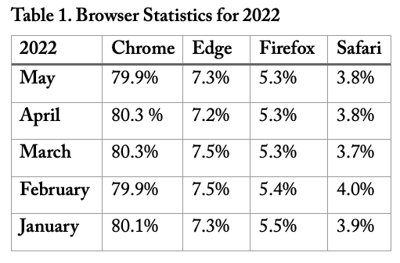
Semantic Structure: Tables
Tables are for tabular data, i.e. data that has a row-column relationship
Do not use tables for visual layout
All table columns must have a heading
Do not merge or split table cells
Do not use blank table rows

Slide 13
Use of Color
Ensure color contrast is sufficient
Only use orange/white color combinations for text >16pt and bold.
Rule of thumb: If you are not sure a color combination has sufficient contrast, it probably does not.
* Office of Strategic Marketing and Branding

Slide 14
Recognizing PDF Accessibility

Slide 15
Characteristics of An Accessible PDF
Searchable text
PDF with only scanned images is not accessible by default
Defined document language and title
Logical semantic structure and reading order
Semantic structure and reading order are defined by the Tag structure
Can ignore Reading Order structure per PDF/UA (ISO 14289-1)
Alternative text descriptions for graphical content
Proper labels for interactive elements, such as form fields and links
Security that does not interfere with assistive technologies (e.g., screen readers)
Fonts that allow extraction of content as text

Slide 16
Accessibility Check Workflow
Start with an accessible source document to export to PDF
Make sure exported to PDF correctly
In Acrobat Pro
Check for Searchable Text
Check Tags Panel for presence of heading tags
Run Accessibility Check tool and fix issues found there
Use Reading Order Tool to check Tag Structure and Reading Order
Check Document Title and Language

Slide 17
DO NOT USE: Acrobat Read Out Loud
Do not use Read Out Loud to check accessibility
Not a screen reader
Text-to-Speech feature
Designed for sighted users with difficulties reading
Does not announce semantic role of contents
Trust the document tags you created

Slide 18
Starting From An Accessible Source
PDFs come from many sources—not all sources allow for accessibility
These applications can create accessible PDFs:
Microsoft Word
Microsoft PowerPoint for Windows
Adobe InDesign
SensusAccess Text Conversion Tool
If your preferred software isn’t on this list, it likely will not work
Printing to PDF or exporting for print does not create accessible PDFs

Slide 19
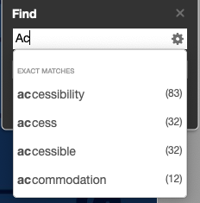
Searchable Text
Try using the find feature to search for visible text
Not accessible if no text is found
Can skip this step if creating PDF and know you exported correctly

Slide 20
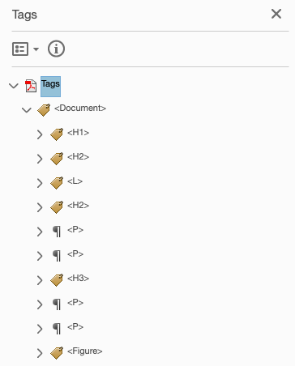
Tag Structure Quick Check
Open the Tags Panel
Look for:
Headings (<H1>, <H2>, etc.)
Lists (<L>)
Paragraphs (<P>)
Figures (<Figure)
If you see only <P> tags, the document is not fully accessible
Probably was auto-tagged

Slide 21
Quick Check: Reading Order (1 of 2)
Arrow through the Tags panel
Check that content is highlighted as expected
InDesign will sometimes get reading order wrong form multicolumn layouts
Can fix by dragging and dropping in Tags panel

Slide 22
Quick Check: Reading Order (2 of 2)
Use Acrobat Page Reflow to display content linearly (i.e. single column)
Like turning off style sheets in a web page
Good for a quick visual spot check
Form fields and decorative content (artifacts) are turned off
Will not be able to see white text that was on a dark background
Turn on by selecting View > Zoom > Reflow
Select again to turn off Reflow view

Slide 23
Accessibility Check Tool (1 of 2)
Open the PDF in Acrobat and run the Accessibility Check from the Tools panel
Use the default options
If you do not see the Accessibility Tools icon in the Tools panel, you need to add the Accessibility tools in the Tools menu

Slide 24
Accessibility Check Tool (2 of 2)
You should see only 2 Document issues in the Accessibility Checker results:
Logical Reading Order
Color Contrast
Fix Title issue if present
Right-click and choose “Fix…”
Description tab of the Document Properties window (File -> Properties…)
Fix Bookmarks issue if present
Likely present if PDF created from PowerPoint

Slide 25
Reading Order Tool: Check Tag Use (1 of 2)
Select “structure types” in the Reading Order tool window
Will change overlay to show the semantic structure of the document
Look for:
Headings (where expected and right order)
Lists
Images marked as figures
Tables, forms, etc.
Blank Lines

Slide 26
Reading Order Tool: Check Tag Use (2 of 2)
Overlays show tag types:
Headings (H1, H2, etc.)
Paragraphs (p)
Lists (LI)
Check that Heading 1 is only used once
May display as two tags if heading wraps
Check all other headings
Check paragraphs
If blank lines are tagged, fix in original
Can select and change to “Background/Artifact” if you feel comfortable doing so

Slide 27
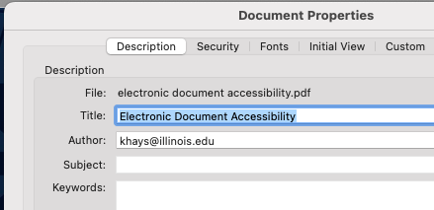
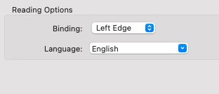
Document Title and Language
Open document properties (File => Properties)
Ensure Title is correct in Description tab
Ensure language is correct in Advanced tab

Slide 28
Fixing Issues

Slide 29
Caveat Draconis
Some documents cannot be fixed
Overlapping images, especially when behind text
Visual content sometimes disappears when editing tags
Save early, save often
Acrobat crashes frequently when fixing tags

Slide 30
Headings
Can retag with the Reading Order tool
Do not worry about headings that have been split due to wrapping to multiple lines
The appearance of a heading is less important than its tag
Infographics, etc., tend to have visual overrides for heading appearance

Slide 31
Alt Text
Fix using the Accessibility Check tool, or
Use the Set Alternate Text tool
If an image is decorative, select “Decorative Figure,” instead of specifying alt text

Slide 32
Lists
List Tag Structure
<L>
<LI>
<Lbl>
<Lbody>
<LI>
<Lbl>
<Lbody>
If lists were not exported correctly, must retag manually using Tags panel
Easiest to start by retagging list items as paragraphs
Create new list tag in Tag panel
Tag will be created at bottom of current sub-item
Create <Lbl> tag in <List> tag
Bullet or number goes in here
Create new <Lbody> for item text

Slide 33
Fixing Reading Order
Use Tags panel to click and drag into correct order
Watch for disappearing content!
InDesign export to PDF will sometimes get tag order wrong
Happens with multi-column layouts
If older reading order must be corrected, drag and drop in the Order panel

Slide 34
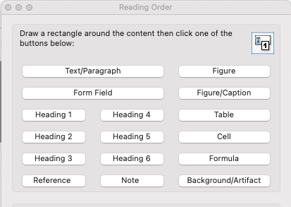
Blank Lines
Use the Reading Order tool
With tool running, select the blank line
Tag as Background/Artifact

Slide 35
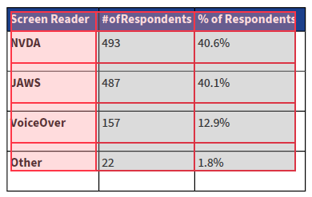
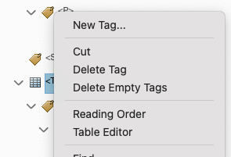
Fixing Table Information
Pull table out of the <p> tag
Right-click on the <Table> tag and select Table Editor

Slide 36
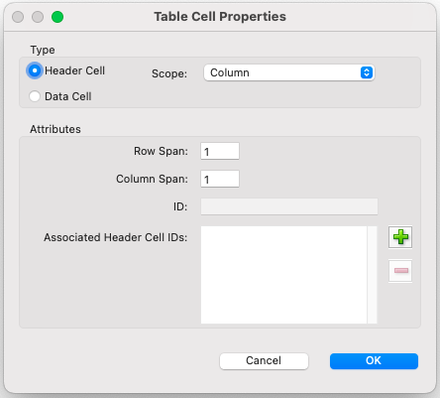
Tables: Column Headers
Click on a column header cell
Right-click and select Table Cell Properties
Ensure Header Cell is selected
Set the Scope to Column

Slide 37
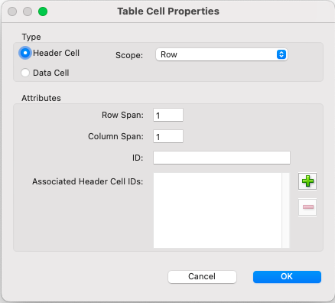
Tables: Row Headers
Click on a row header cell
Right-click and select Table Cell Properties
Ensure Header Cell is selected
Set the Scope to Row

Slide 38
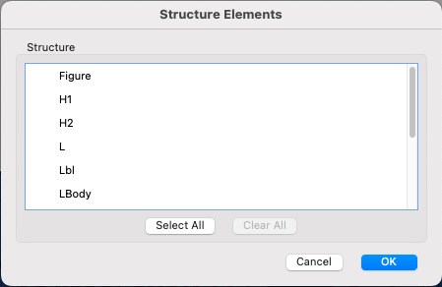
Bookmarks (PowerPoint Conversions)
Will see ”Bookmarks--Failed” in Accessibility Check tool
Right-click on error and select “Fix”
Choose H1 and H2 tags from the list in Structure Elements
Click OK.

Slide 39
Questions?

Slide 40
Learn More
Accessibility 101 – https://canvas.instructure.com/courses/1130292
Open Online Course in Accessibility and Inclusive Design – https://citl.illinois.edu/about-citl/news/2019/07/08/university-of-illinois-launches-open-online-course-in-accessibility-and-inclusive-design-on-coursera
Information Accessibility, Design, and Policy Certificate Program – http://iadp.ahs.illinois.edu/
Create and Verify PDF Accessibility – https://helpx.adobe.com/acrobat/using/create-verify-pdf-accessibility.html#make_PDFs_accessible
PDF/UA In a Nutshell – https://www.pdfa.org/wp-content/until2016_uploads/2013/08/PDFUA-in-a-Nutshell-PDFUA.pdf
PDF Accessibility for ADA Compliance – https://www.adobe.com/max/2020/sessions/pdf-accessibility-for-ada-compliance-s6809.html
Accessible Tables with Adobe InDesign – https://www.youtube.com/embed/Bo60TEE2oyA
Accessible Charts and Graphs – https://www.youtube.com/embed/Bo60TEE2oyA

Slide 41
Important Resources
Report a Barrier
Help us identify and remediate issues that you come across– it really does take everyone to create an inclusive community.
We follow up personally and explain the review process and outcome for each barrier reported.
IT Accessibility Website
Accessibility tips and links to resources
Information about the IT Accessibility Liaison program
EIT accessibility policy information
DRES academic accommodations
Request a reasonable accommodation – faculty and staff (including GA/TA workplace accommodations)

